Slide 1
AI Booster – Week 02 Session 02 – Univariate stats
Franck JAOTOMBO & Antoine SCHERRER ascherrer@em-lyon.com
Notes:
Let me introduce myself :
Write name on the board : Franck JAOTOMBO
Double training : applied maths and management / organizational behavior
3 Masters degrees : Physics, Philosophy & Maths
1 Ph.D : Management Sciences
I have been in the training business most of my life chiefly as an entrepreneur and /or self-employed
Currently I mainly carry on three taks :
Teach in business schools
Implement statistical studies for colleagues researchers
Work as a free lance data scientist and statitiscian

Slide 2
Outline & Program
One week dedicated to improve your python programming skills and review basic statistical notions
Day 1 => Introduction, data, data cleaning
Day 2 (today!) => Univariate statistics
Day 3 => Bivariate statistics
Day 4 => Hypothesis testing and important distributions
Day 5 => Review linear algebra

Slide 3
Teaching / learning materials
Every day will follow the same schedule
1h30 of lecture (or less)
1h30 of in-class pratice (live coding session)
Afternoon dedicated to practice (Tues., Wed., Thur. With a teaching assistant)
Evaluation => individual quizz at the end of the week + group project (at the end of week 3)

Slide 4
Representing data with tables
Tables and Frequency Distributions

Slide 5
Organizing Qualitative Data: Summary Table
A summary table indicates the frequency (amount) or percentage of items in a set of categories so that differences between categories can be seen.
Summary Table From A Survey of 1000 Banking Customers
Banking Preference? | Percent
ATM | 16%
Automated or live telephone | 2%
Drive-through service at branch | 17%
In person at branch | 41%
Internet | 24%

Slide 6
Organizing Quantitative Data: Frequency Distribution
The frequency distribution is a summary table in which the data are arranged into numerically ordered classes.
You must pay attention to selecting the appropriate number of class groupings (or bins) for the table, determining a suitable width of a class grouping, and establishing the boundaries of each class grouping to avoid overlapping.
The number of classes depends on the number of values in the data. With a larger number of values, typically there are more classes. In general, a frequency distribution should have at least 5 but no more than 15 classes.
To determine the width of a class interval, you divide the range (Highest value–Lowest value) of the data by the number of class groupings desired.

Slide 8
Organizing Quantitative Data: Frequency Distribution Example
Data in ordered array:
12, 13, 17, 21, 24, 24, 26, 27, 27, 30, 32, 35, 37, 38, 41, 43, 44, 46, 53, 58
Class Midpoints Frequency
10 but less than 20 15 3
20 but less than 30 25 6
30 but less than 40 35 5
40 but less than 50 45 4
50 but less than 60 55 2
Total 20

Slide 9
Relative & Percent Frequency Distribution Example
Data in ordered array:
12, 13, 17, 21, 24, 24, 26, 27, 27, 30, 32, 35, 37, 38, 41, 43, 44, 46, 53, 58
Relative
Frequency
Class Frequency
Percentage
10 but less than 20 3 .15 15
20 but less than 30 6 .30 30
30 but less than 40 5 .25 25
40 but less than 50 4 .20 20
50 but less than 60 2 .10 10
Total 20 1.00 100

Slide 10
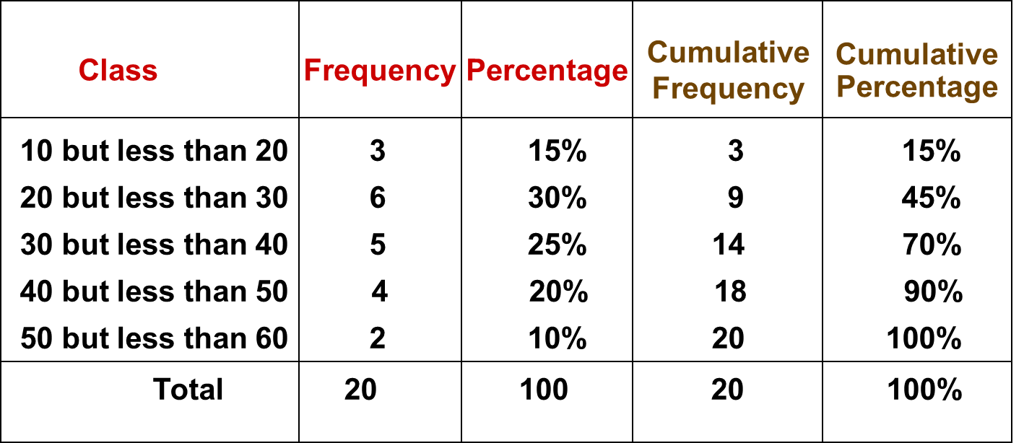
Cumulative Frequency Distribution Example
Data in ordered array:
12, 13, 17, 21, 24, 24, 26, 27, 27, 30, 32, 35, 37, 38, 41, 43, 44, 46, 53, 58

Slide 11
Representing Data Graphically
Charts, Bars, Pies, Boxplots

Slide 12
Visualizing Qualitative Data Through Graphical Displays
Qualitative Data
Visualizing Data
Summary Table For One Variable
Contingency Table For Two Variables
Bar
Chart
Pareto
Chart
Side By Side Bar/Pie Chart
Or Stacked Bar Chart
Pie Chart

Slide 13
Visualizing qualitative Data: The Bar Chart
In a bar chart, each bar shows a category of the variable, the length of which represents the frequency (amount) or percentage of values falling into the category (based on the summary table of the variable).
Banking Preference? | %
ATM | 16%
Automated or live telephone | 2%
Drive-through service at branch | 17%
In person at branch | 41%
Internet | 24%

Slide 14
Visualizing qualitative Data: The Pie Chart
The pie chart is a circle broken up into slices that represent categories of the variable. The size of each slice is proportional to the percentage of each category.
Banking Preference? | %
ATM | 16%
Automated or live telephone | 2%
Drive-through service at branch | 17%
In person at branch | 41%
Internet | 24%

Slide 15
Visualizing qualitative Data: The Pareto Chart
Used to portray qualitative data
A vertical bar chart, where categories are shown in descending order of frequency
A cumulative polygon is shown in the same graph

Slide 16
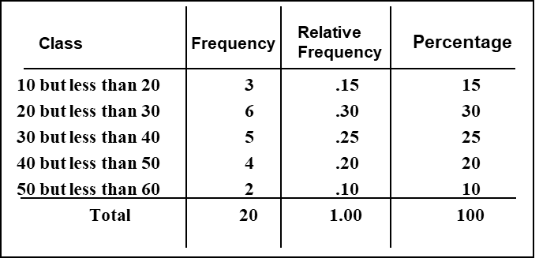
Visualizing Quantitative Data: The Histogram
A vertical bar chart of the data in a frequency distribution is called a histogram.
In a histogram there are no gaps between adjacent bars.
The class boundaries (or class midpoints) are shown on the horizontal axis.
The vertical axis is either frequency, relative frequency or percentage.
The height of the bars represent the frequency, relative frequency or percentage.
(In a percentage histogram the vertical axis would be defined to show the percentage of observations per class)

Slide 17
Visualizing Quantitative Data: The Polygon (line chart) & Ogive
A frequency (or percentage) polygon is formed by having the midpoint of each class represent the data in that class and then connecting the sequence of midpoints at their respective class frequencies (or percentages).
The cumulative frequency (or percentage) polygon, called ogive, displays the variable of interest along the X axis, and the cumulative frequencies (or percentages) along the Y axis.
Useful when there are two or more groups to compare.

Slide 18
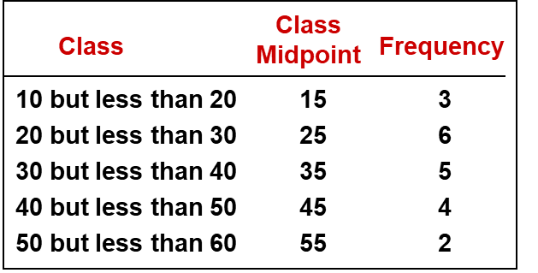
Visualizing Quantitative Data: The Frequency Polygon
(In a percentage polygon the vertical axis would be defined to show the percentage of observations per class)

Slide 19
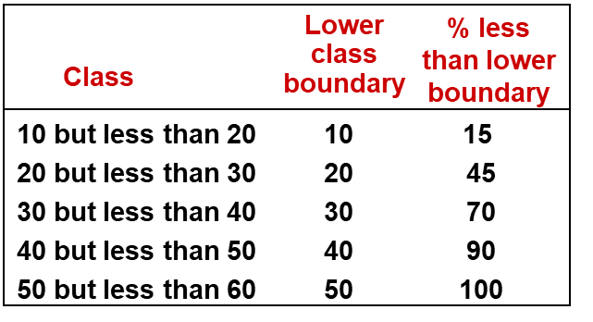
Visualizing Quantitative Data: The Ogive (Cumulative % Polygon)
(In an ogive the percentage of the observations less than each lower class boundary are plotted versus the lower class boundaries.

Slide 20
Principles of Excellent Graphs
The graph should not distort the data.
The graph should not contain unnecessary adornments (sometimes referred to as chart junk).
The scale on the vertical axis should begin at zero.
All axes should be properly labeled.
The graph should have a title.
The simplest possible graph should be used for a given set of data.

Slide 21
Any questions ? + Let’s start coding !

